Slide 1
Formula 1 Driver and Teams roster Jordan Lee

Slide 2
Introduction
MVP: Full Stack Web Application
Components
Spring Application, HTML pages, Javascript, SQL databases
Scope
- Feature-branch model, Jira project management board, Risk assessment, relational databases modelled using ERD

Slide 3
Risk Assessment

Slide 4
MoSCoW

Slide 5
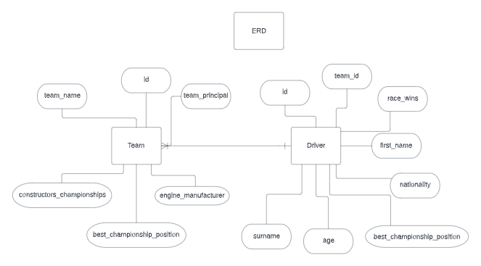
ERD

Slide 6
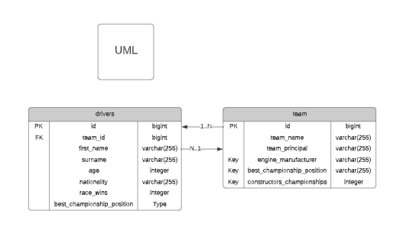
UML

Slide 7
Sprints
1 Sprint
Epics
Backend Drivers, Backend Teams, Webpage
User Stories – 4-6 for each epic covering MVP

Slide 8

User Stories and Tasks
What is a user story?
Adding them to epic
Some examples…
What is a task?

Slide 9
GitHub
Main branch
Dev branch
Feature branches
Commit messages

Slide 10

Let’s take a look..
Version Control

Slide 11
Testing
What I managed to test
What I didn’t manage to test

Slide 12

Test Coverage
How much test coverage achieved?
Industry standard is 80%

Slide 13
Sprint Review
What went well
What didn’t go well
What goals took too long
What goals were missed

Slide 14

Live Demo

Slide 15
Developer Journey
Skills needed for project
- Spring, HTML, JS, Selenium, SonarQube
What have I learned? - A lot!
How it has allowed me to complete project

Slide 16

Thanks for listening

